Slide 1
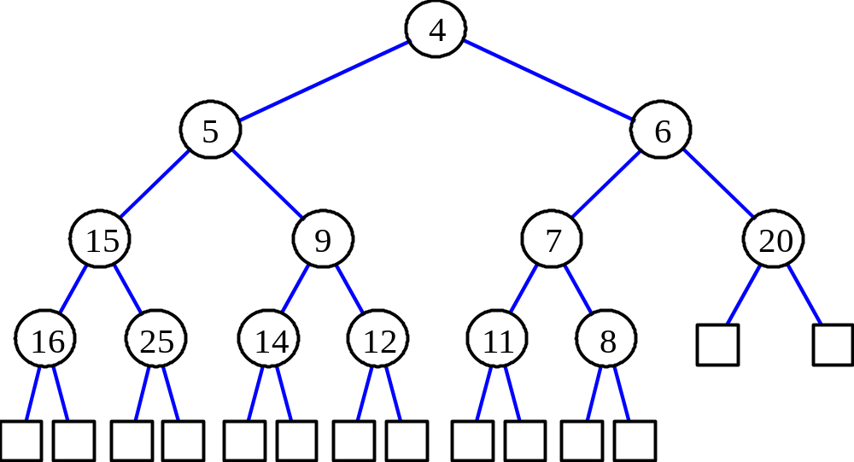
Heaps
A heap is a binary tree T that stores a key-element pairs at its internal nodes
It satisfies two properties:
  MinHeap: key(parent) ≤ key(child)
  [OR MaxHeap: key(parent) >= key(child)]
  all levels are full, except
  the last one, which is
  left-filled

Slide 2

What are Heaps Useful for?
To implement priority queues
Priority queue = a queue where all elements have a “priority” associated with them
Remove in a priority queue removes the element with the smallest priority
  insert
  removeMin

Slide 3
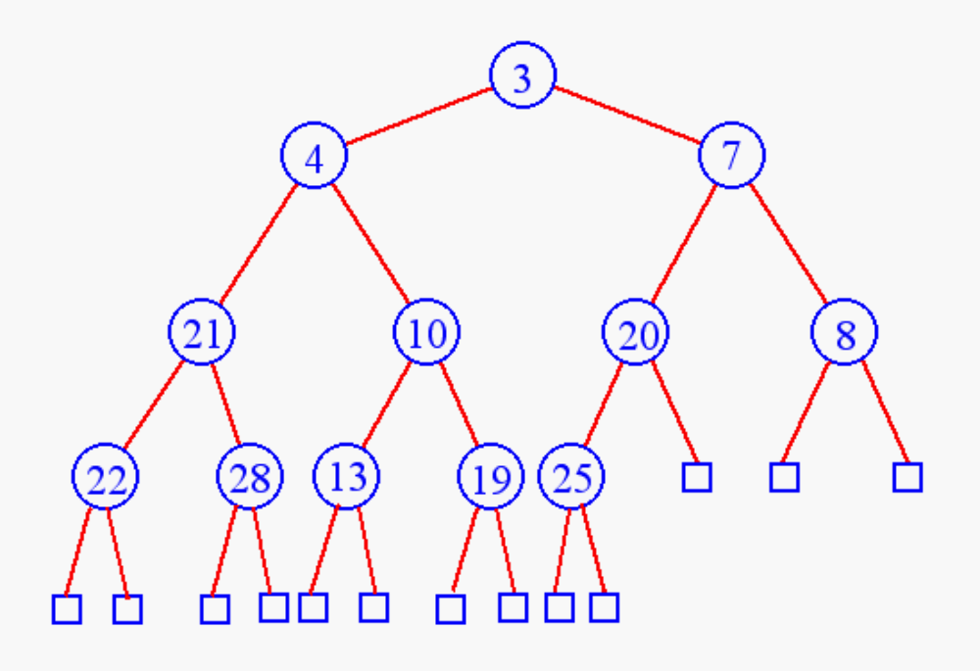
Heap Insertion
Insert 6

Slide 4
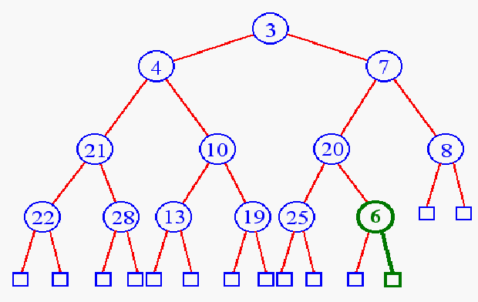
Heap Insertion
Add key in next available position

Slide 5
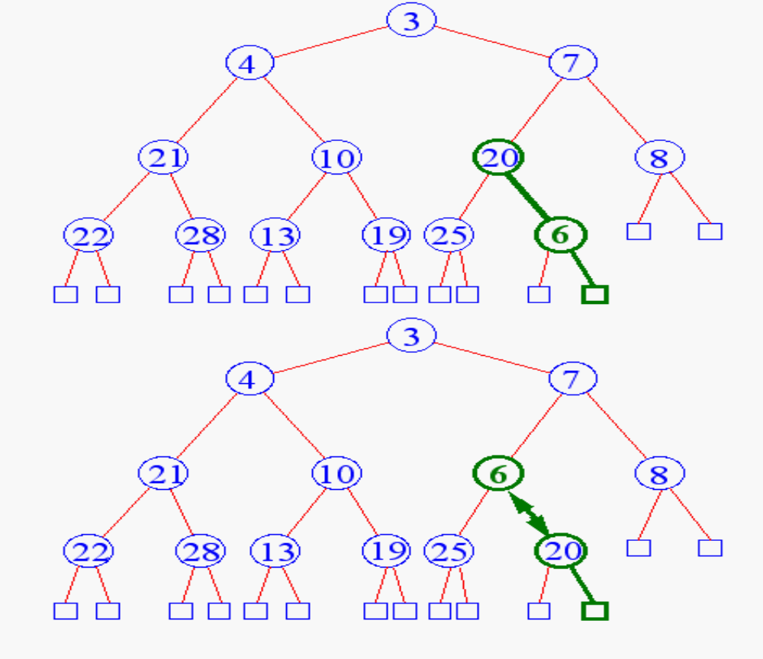
Heap Insertion
Begin Unheap

Slide 6
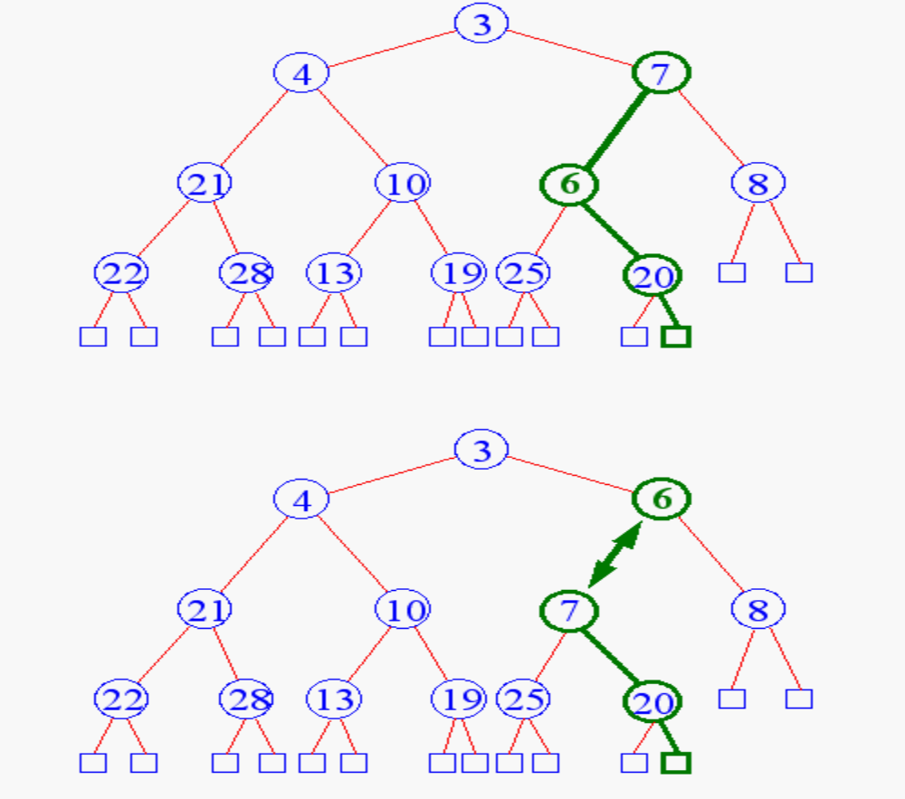
Heap Insertion

Slide 7
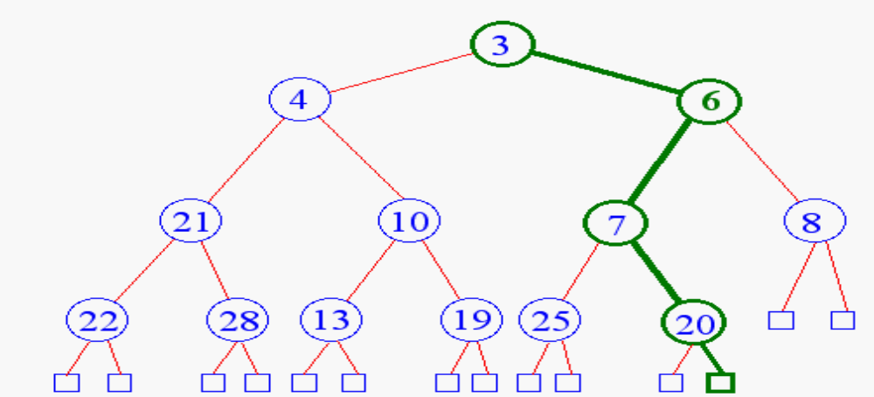
Heap Insertion
Terminate unheap when
  reach root
  key child is greater than key parent

Slide 8
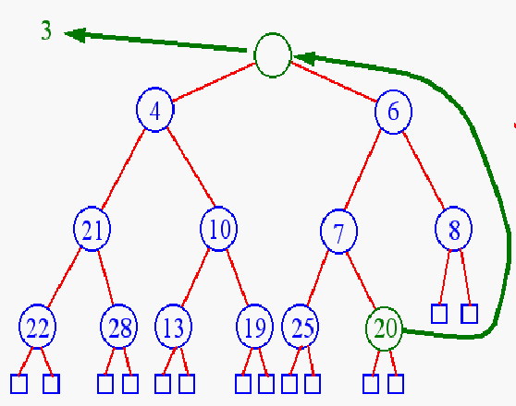
Heap Removal
Remove element
from priority queues?
removeMin( )

Slide 9
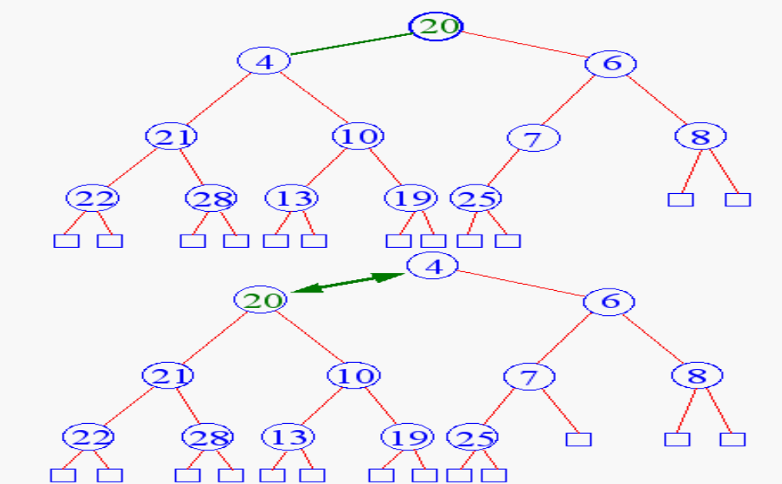
Heap Removal
Begin downheap

Slide 10
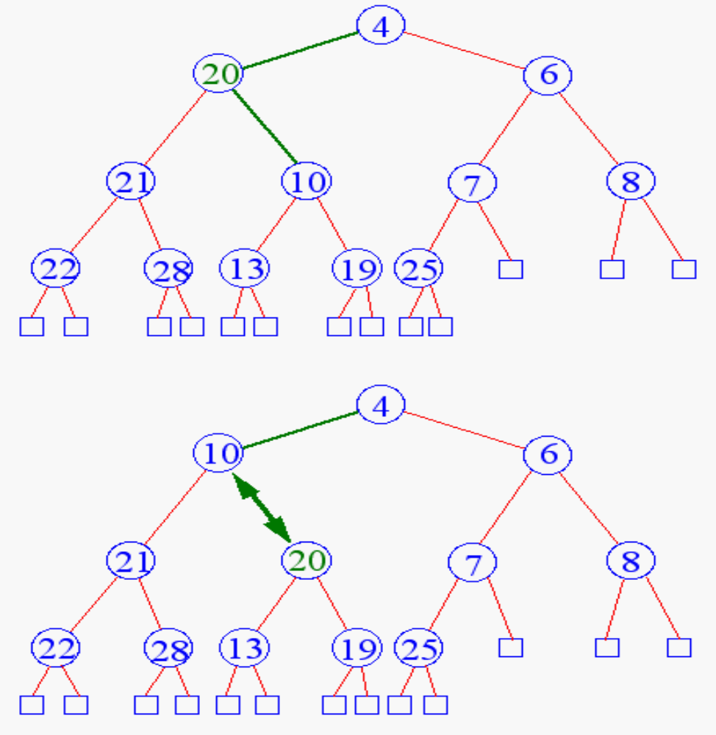
Heap Removal

Slide 11
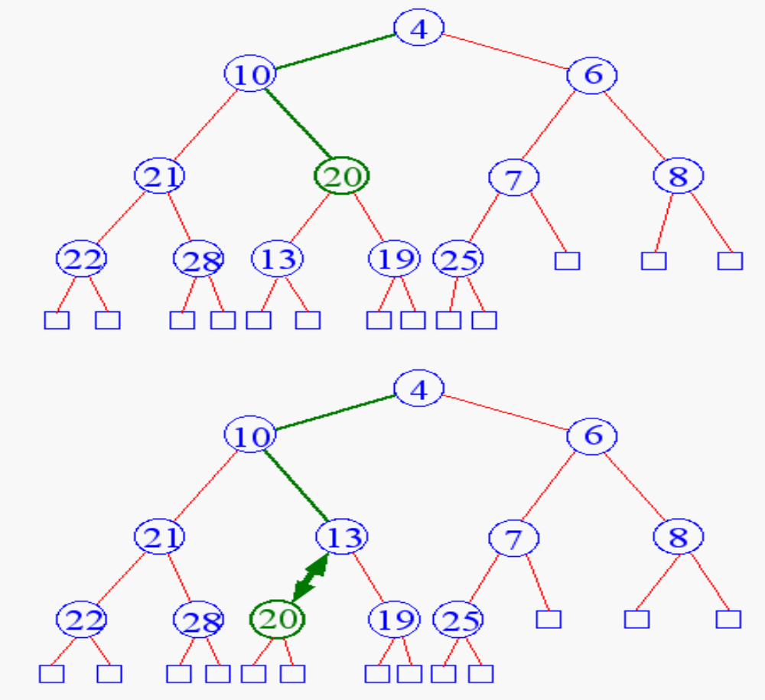
Heap Removal

Slide 12
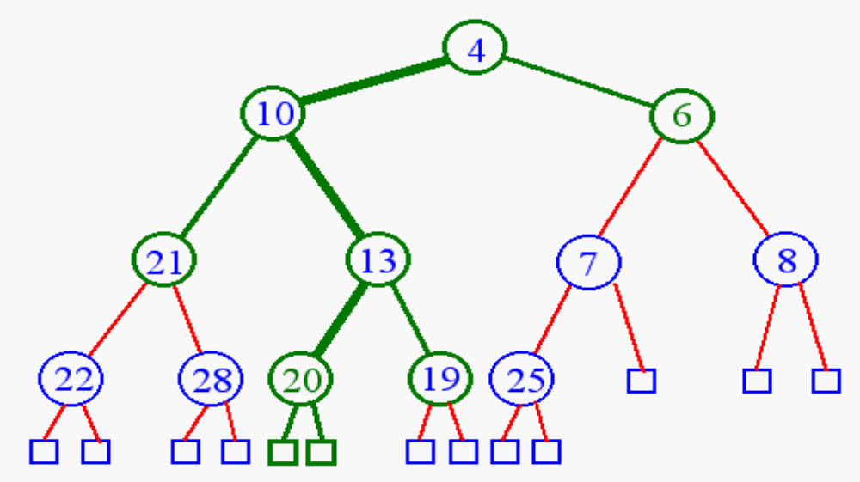
Heap Removal
Terminate downheap when
  reach leaf level
  key parent is greater than key child

Slide 13
InsHeap (Tree, N, Item)
A Heap H with N elements is stored in array Tree and Item of information is given. Ptr gives location of Item as it rises in tree and Par denotes location of parent of Item
1. Set N := N+1 and Ptr = N [Add new node to H and initialize Ptr]
[Find location to insert Item]
Repeat steps 3 to 6 while Ptr >1
Set Par := [Ptr/2] [Location of parent node]
If Item <= Tree[Par], then
Set Tree[Ptr] := Item and Return
[End of If structure]
Set Tree[Ptr] := Tree[Par] [Moves node down]
Set Ptr := Par [Updates Ptr]
[End of step 2 loop]
Set Tree[1] := Item [Assign Item as root of H]
Return

Slide 14
DelHeap (Tree, N, Item)
A Heap H with N elements is stored in array Tree. Variable Last saves value of original last node of H. Pointers Ptr, Left and Right give locations of Last and its left & right children as Last sinks in tree.
Set Item := Tree[1] [Removes root of H]
Set Last := Tree[N] and N:=N-1 [Removes last node of H]
Set Ptr:= 1, Left:= 2 and Right:= 3 [Initializes pointers]
Repeat Steps 5 to 7 while Right <=N
If Last >= Tree[Left] and Last >= Tree[Right], then
Set Tree[Ptr] := Last and Return
[End of If structure]
If Tree[Right] <= Tree[Left], then
Set Tree[Ptr] := Tree[Left] and Ptr := Left
Else
Set Tree[Ptr] := Tree[Right] and Ptr := Right
[End of If structure]
Set Left := 2*Ptr and Right := Left +1
[End of Step 4 loop]
If Left = N and if Last < Tree[Left],
then Set Tree[PTR] = Tree[Left] and Ptr := Left
Set Tree[Ptr] := Last
Return

Slide 15
HeapSort (A, N)
An array A with N elements is given. This algo. sorts elements of A.
[Build a Heap H]
Repeat for J=1 to N-1
Call InsHeap(A, J, A[J+1]) //InsHeap (Tree, N, Item)
[End of loop]
[Sort A by repeatedly deleting root of H]
Repeat while N>1
a) Call DelHeap(A, N, Item)
b) Set A[N+1] := Item
[End of loop]
3. Exit

